Slide 1
DATA STRUCTURES AND ITS APPLICATIONS (UE22CS252A)
Mini Project

Slide 2
Project Title & Team Members
Title:
Implementation of Railway Reservation System using Linked Lists in C
Team Members (SRN Name):
PES2UG22CS323 MRUNAL ANANDACHE
PES2UG22CS361 NIKITA ANUP
PES2UG22CS362 NIKITHA THAMMAIAH

Slide 3
ADT:
PROGRAMMING LANGUAGE | C
DATA STRUCTURE | SINGLE LINKED LIST
OPERATIONS:
View Train Schedule
Display Available Seats
Book Ticket
Cancel Ticket

Slide 4
Contribution of each Team Member
This should be last slide mentioning contribution of each member
Mrunal Anandanche (PES2UG22CS323):
Implementation of struct Reservation, struct Schedule and main function.
Nikita Anup (PES2UG22CS361):
Implementation of createReservation(), createSchedule(), displayAvailableSeats()
Nikitha Thammaiah(PES2UG22CS362):
Implementation of bookTicket(), cancelReservation() and freeList()

Slide 5
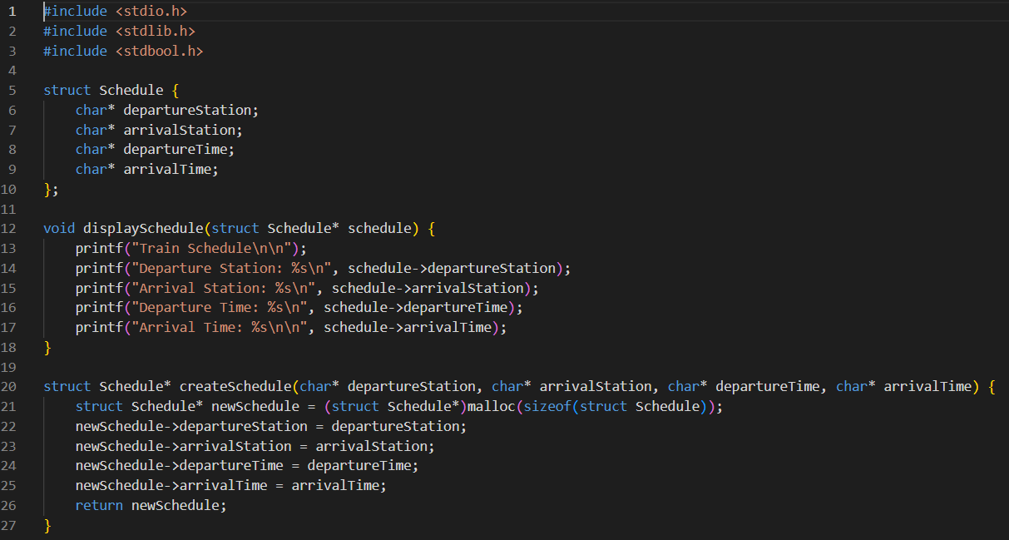
CODE:

Slide 6
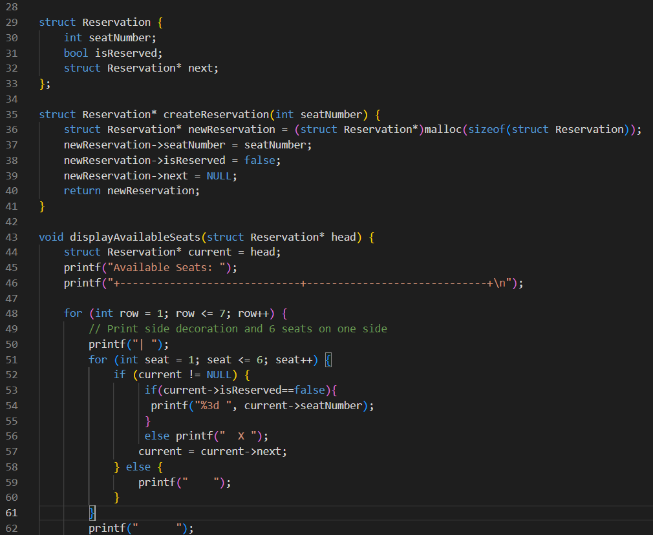

Slide 7
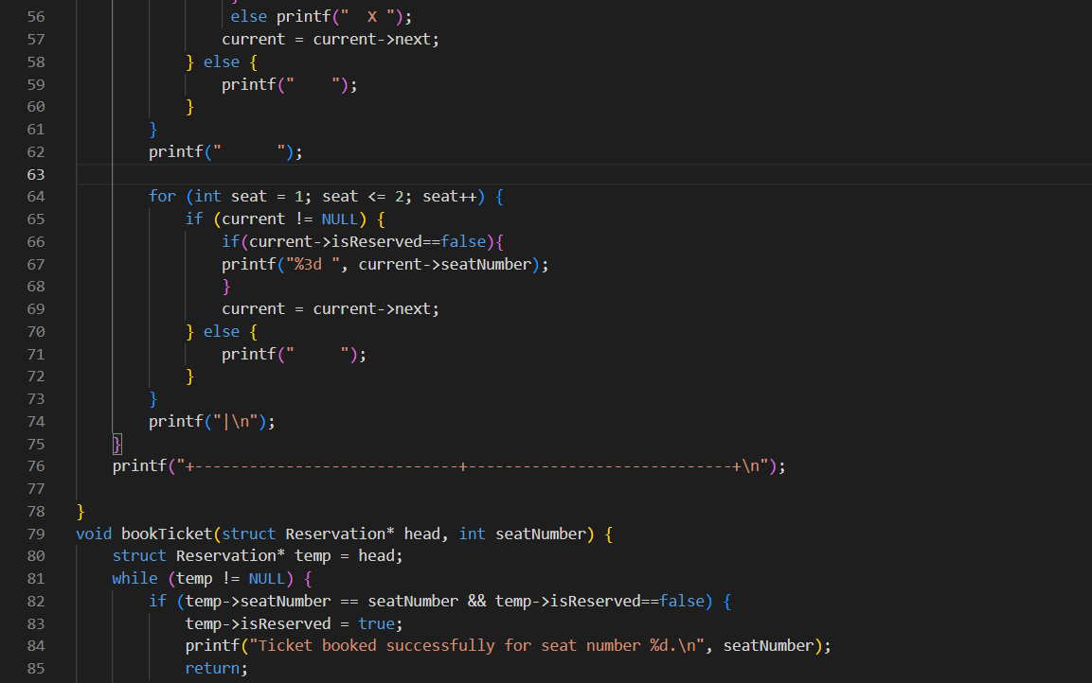

Slide 8
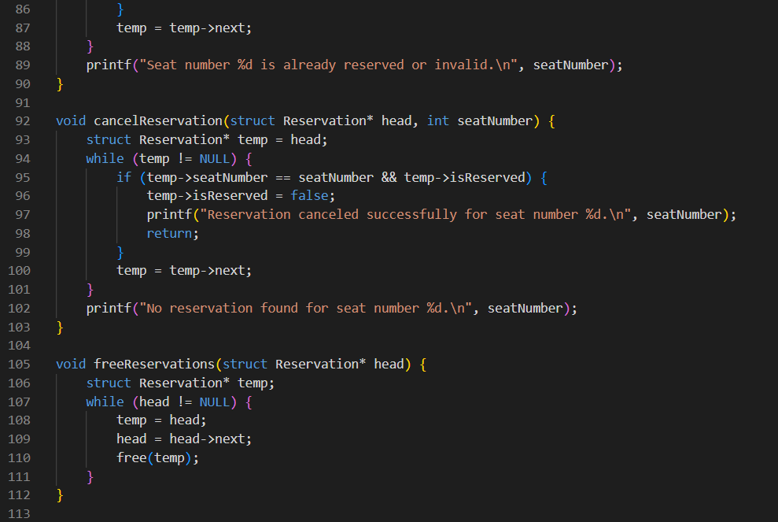

Slide 9
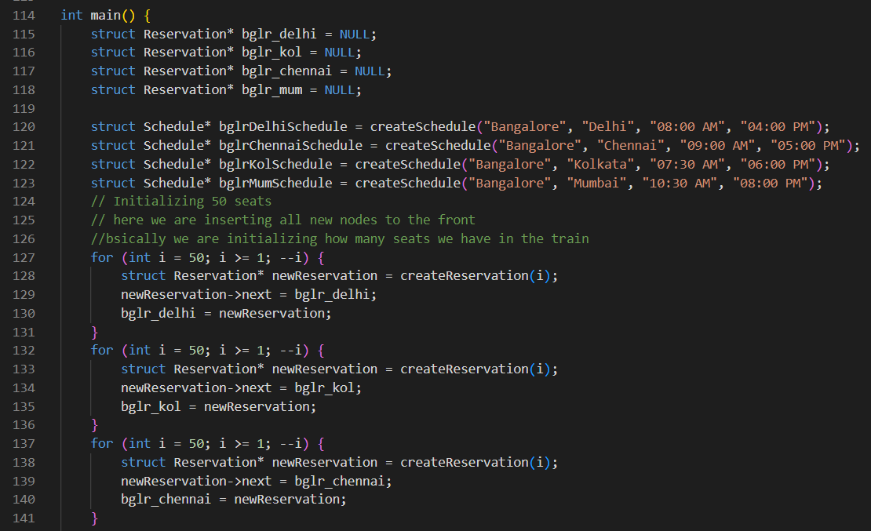

Slide 10
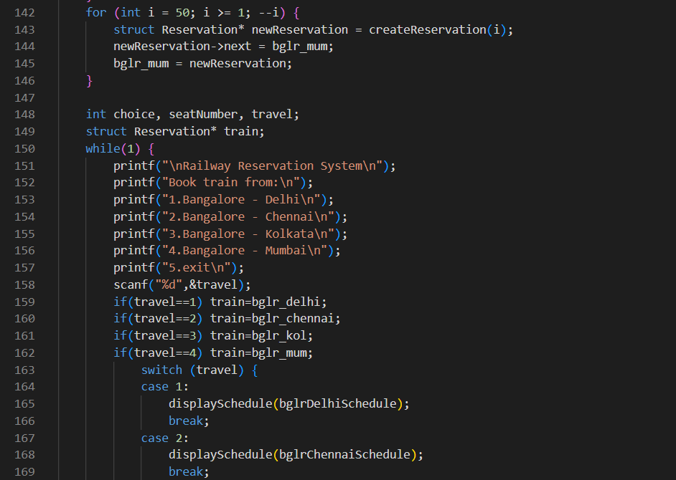

Slide 11
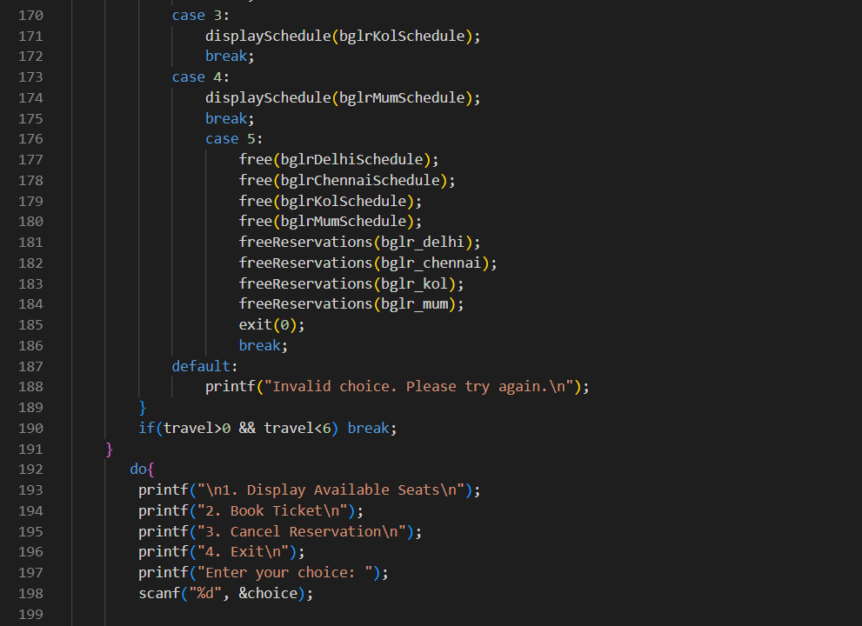

Slide 12
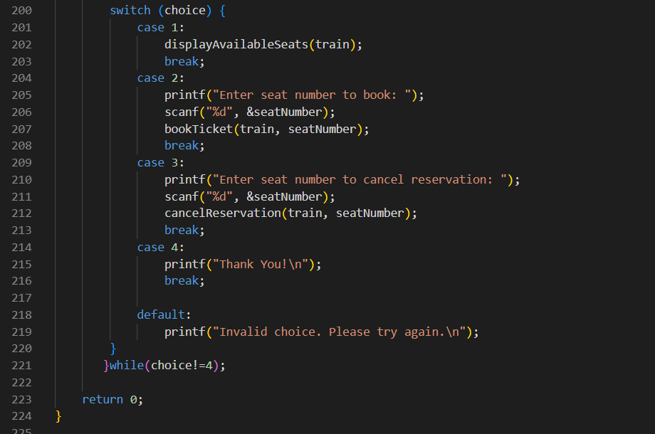

Slide 13
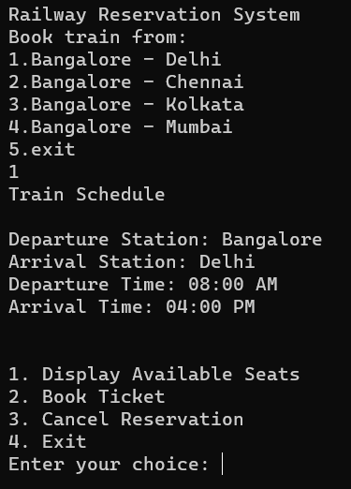
OUTPUT:
1) DISPLAYING TRAIN SCHEDULE

Slide 14
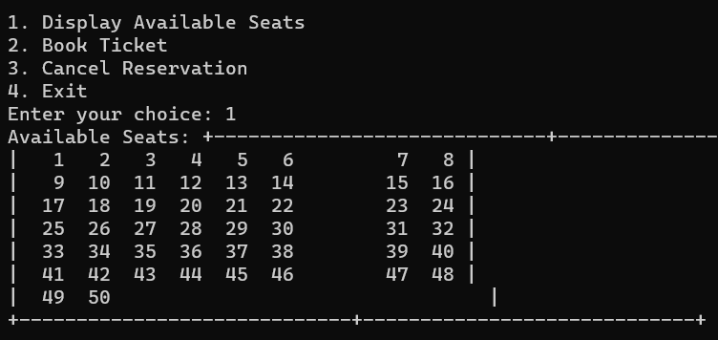
2) DISPLAYING AVAILABLE SEATS

Slide 15
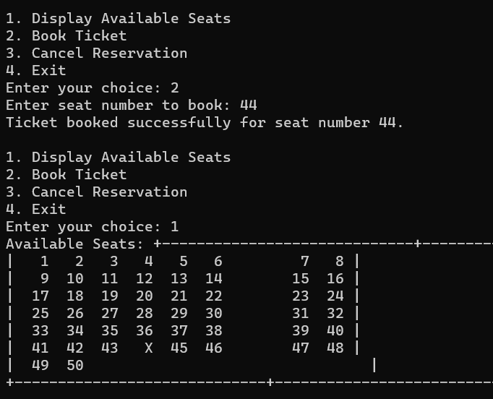
3) BOOKING TRAIN TICKET

Slide 16
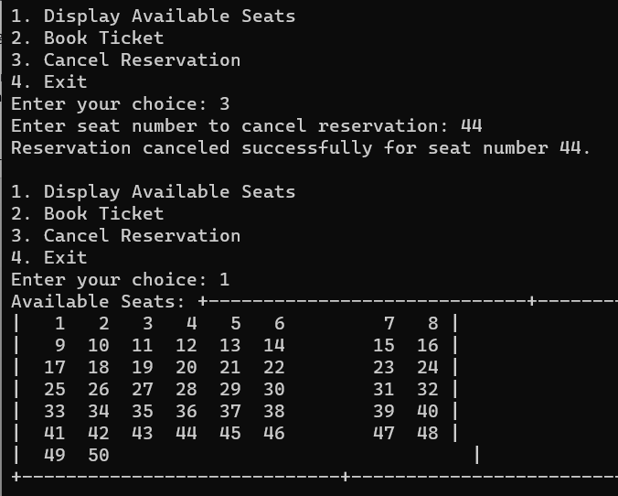
4) CANCELLING TRAIN TICKET

